Slide 1
ICD
Courtesy: https://www.aapc.com/, https://www.cms.gov/

Slide 2
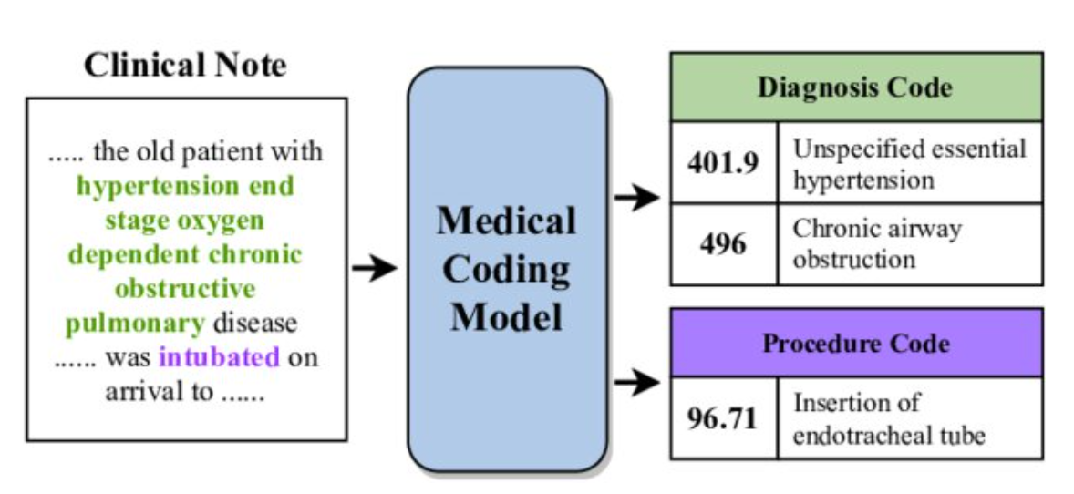

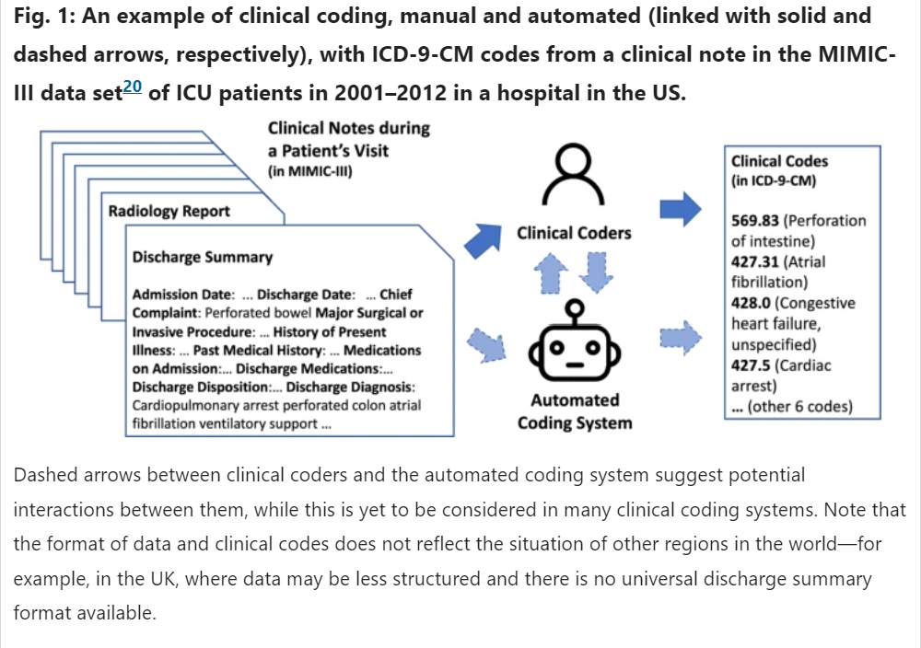
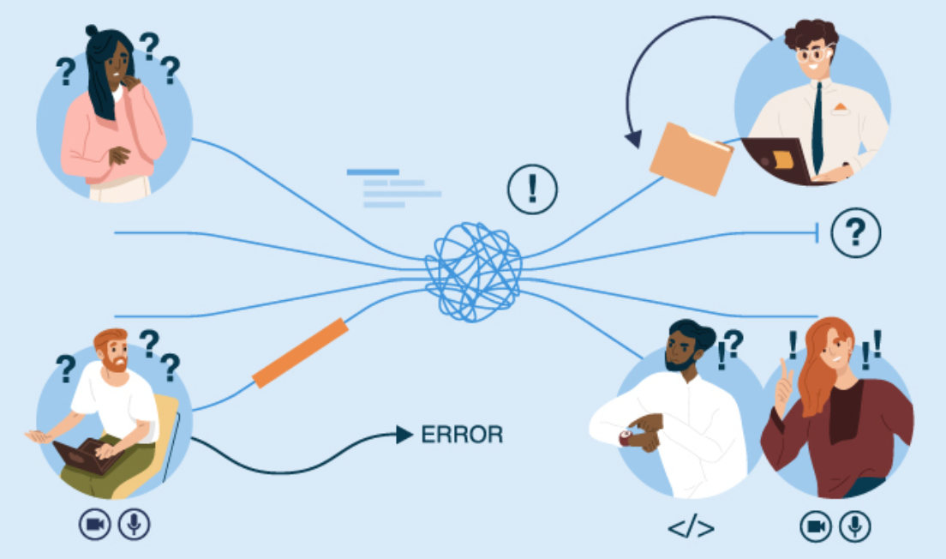

Medical Communication
https://www.researchgate.net/publication/357734346_A_Unified_Review_of_Deep_Learning_for_Automated_Medical_Coding/figures?lo=1
https://www.nature.com/articles/s41746-022-00705-7

Slide 3
ICD9 or ICD10
ICD: International Statistical Classification of Diseases and Related Health Problem
It is a medical classification by the World Health Organization (WHO)
It contains codes for diseases, signs and symptoms, abnormal findings, complaints, social circumstances, and external causes of injury or diseases
ICD 10 is the 10th version of ICD, and first used by member states in 1994.
In the base classification, ICD allows more than 14,000 different codes and member states have expanded the code set by, for example, specifying the cause of injury, or adding procedure codes.

Slide 4
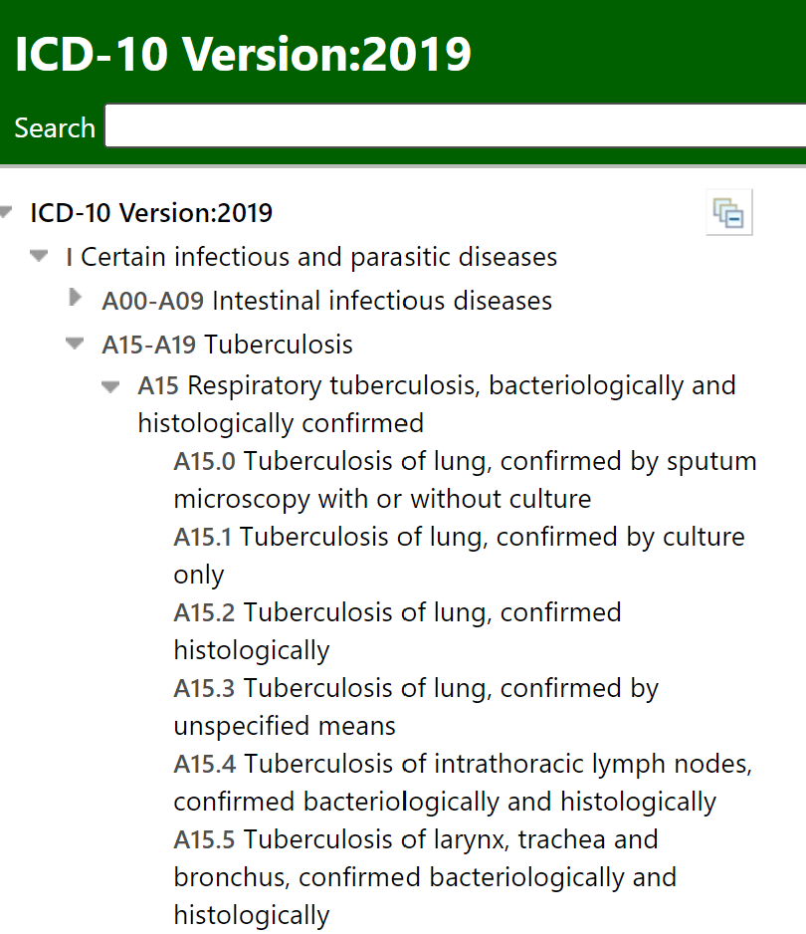
ICD 10
ICD is a classification of diseases which defines as a system of categories to which morbid entities are assigned according to established criteria.
The purpose of the ICD is to permit systematic recording, analysis, interpretation and comparison of mortality and morbidity data collected in different countries or areas, and at different times.
It translates diagnoses of diseases and other health problems from words into an alphanumeric code, which permits easy storage, retrieval, and analysis of data.
https://icd.who.int/browse10/Content/statichtml/ICD10Volume2_en_2016.pdf

Slide 5
ICD10
ICD’s original use was to classify causes of mortality as recorded at the registration of death.
Later, its scope was extended to include diagnoses in morbidity.

Slide 6
ICD10
It does not provide sufficient details on different attributes of health conditions
It does not describe functioning and disability as aspects of health (it is in the International Classification of Functioning, Disability and Health (ICF)).
It does not include a full array of health interventions or reasons for encounter

Slide 7
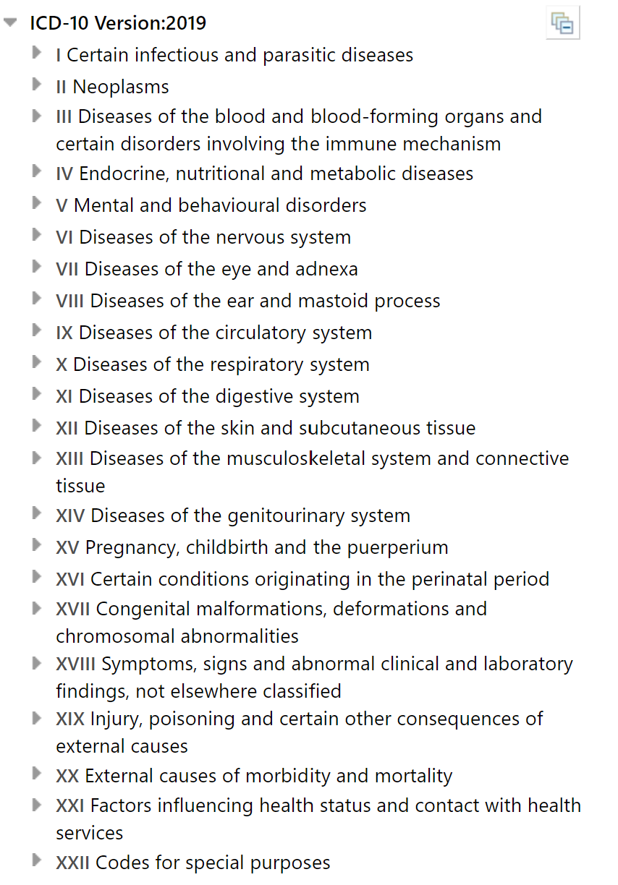
ICD10
The core concept of ICD10 is “family” – a suite of integrated classification products that share similar features and can be singularly or jointly to provide information on different aspects of health and healthcare system.
ICD is part of WHO-FIC
WHO Family of International Classifications (WHO-FIC) aims to provide a conceptual framework of information dimensions that are related to health and health management.
WHO FIC strives to build the family of classifications based on sound scientific and taxonomic principles, in culturally appropriate and internationally applicable, and focuses on the multidimensional aspects of health.

Slide 8
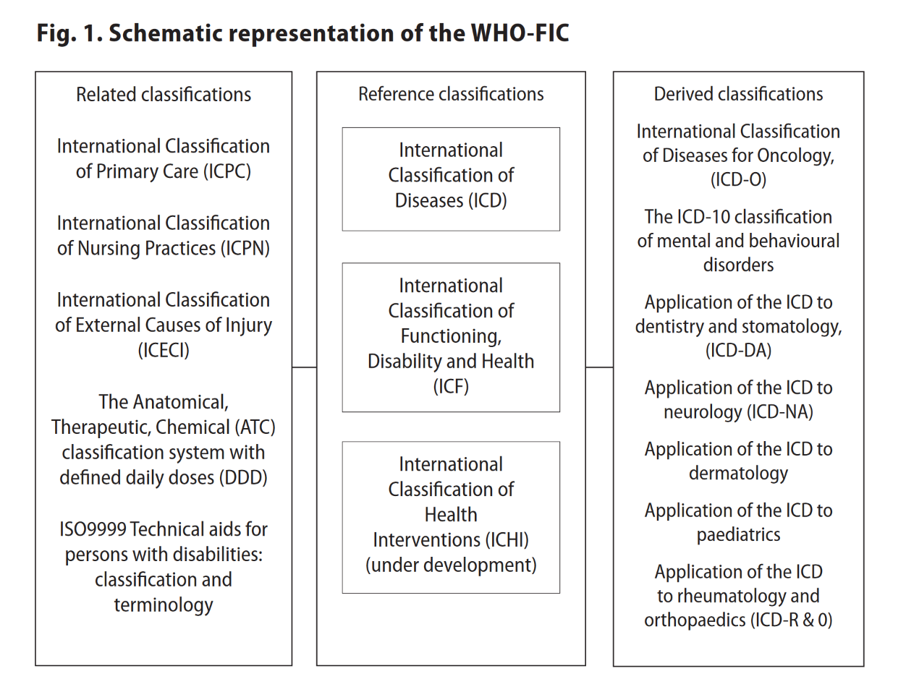
WHO-FIC

Slide 9
Adaptation
Oncology: ICD-O coding system for malignant neoplasms, also allow greater specificity for non-malignant neoplasms.
Dermatology
Dentistry and Stomatology
Neurology
Rheumatology and orthopedics

Slide 10
Non-diagnostic classifications
International Classification of functioning, disability and health (ICF)
Part 1: classifications for functioning and disability
Body functions and structures
Activities and participation
Part 2: environmental and personal contextual factors
ICF uses an alphanumeric system in which the letters b, s, d and e are used to denote body functions, body structures, activities, and participation and environmental factors, respectively.
These letters are followed by a numeric code that starts with the chapter number (one digit), followed by the second level (two digits), and the third and fourth levels (one digit each)

Slide 11
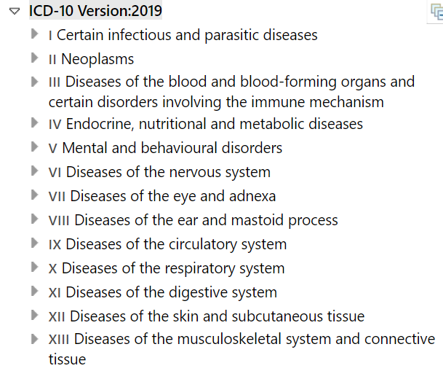
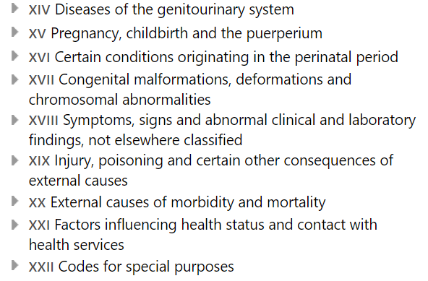
ICD10 CM (Clinical Modification) overview

Slide 12
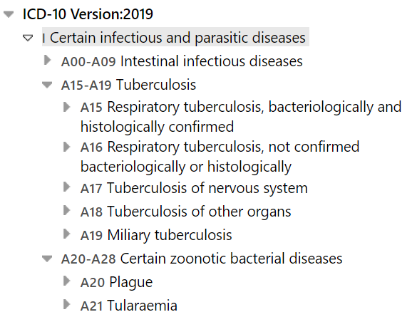
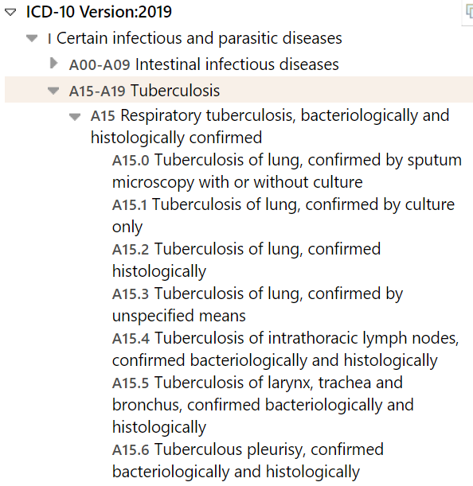
ICD 10 CM (Clinical Modification) overview

Slide 13


Funny ICD 10 Code
https://etactics.com/blog/funny-icd-10-codes

Slide 14
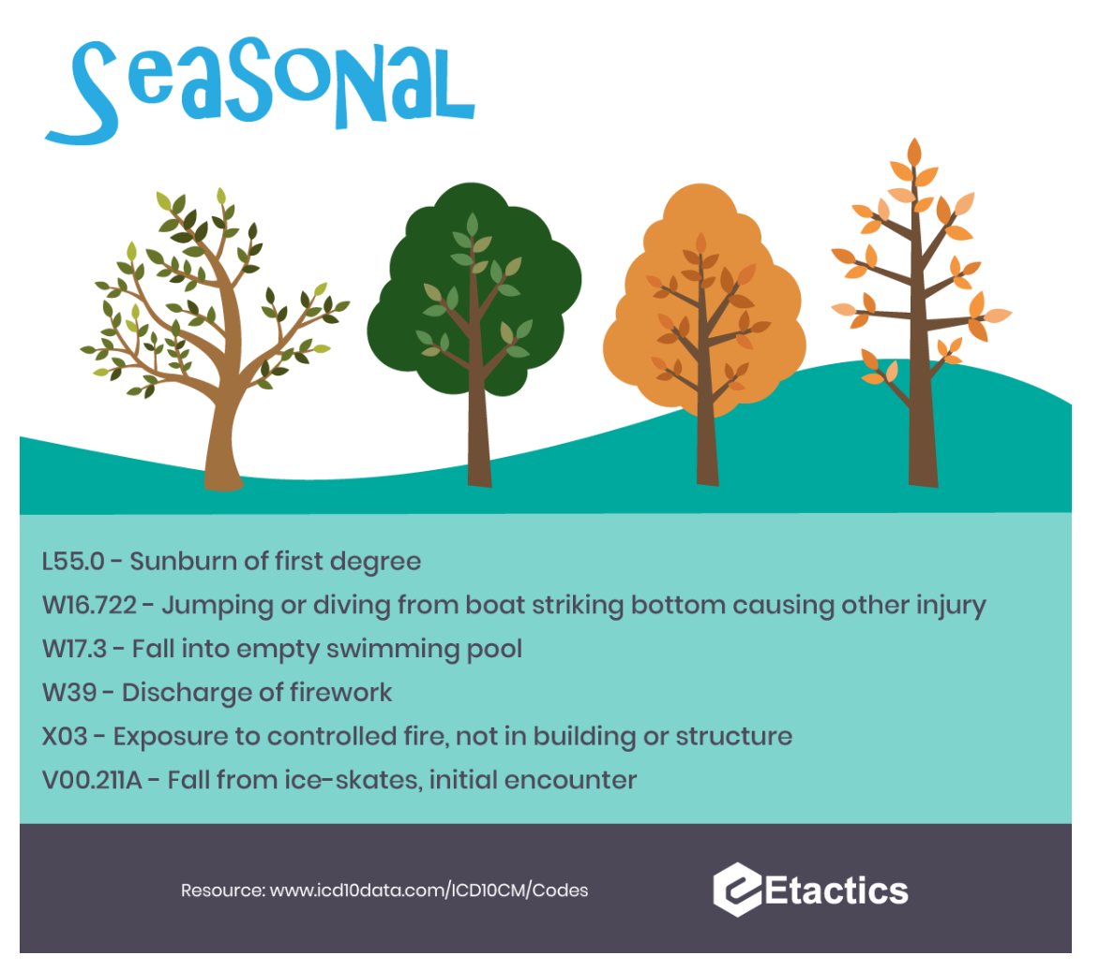

Funny ICD 10 Code

Slide 15
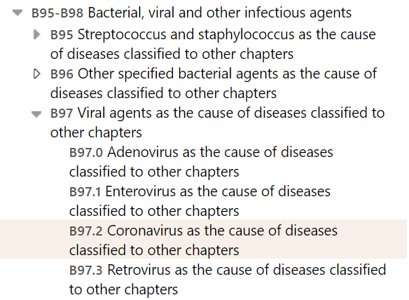
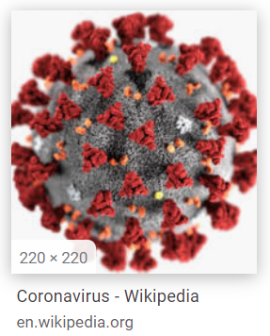
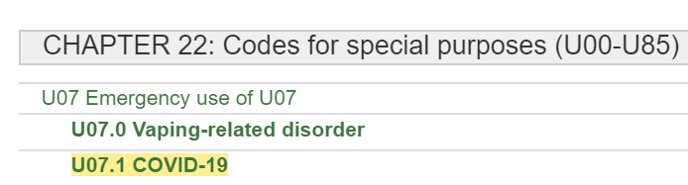
ICD10 CM - Coronavirus
Browser
https://icd.who.int/browse10/2019/en (WHO)
https://icd10cmtool.cdc.gov/ (CDC)

Slide 16
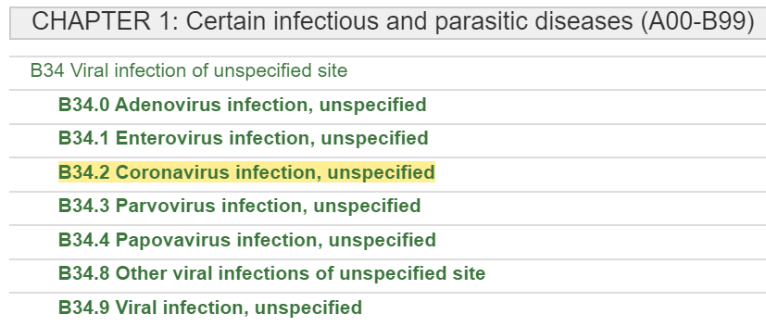
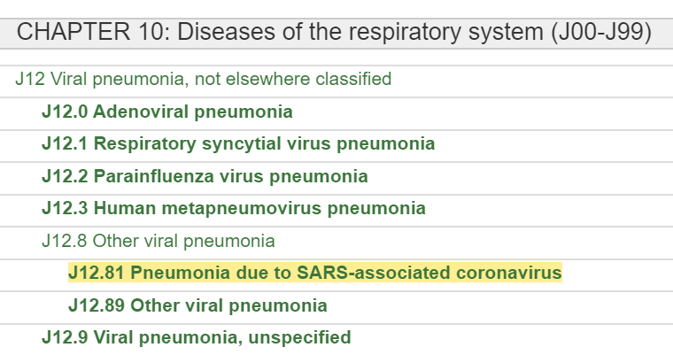
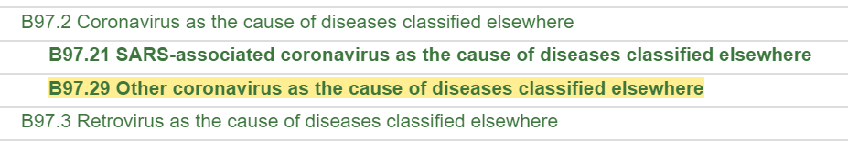
ICD10 CM - Coronavirus

Slide 17
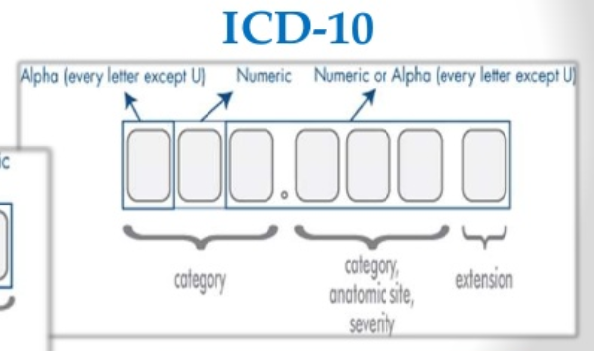
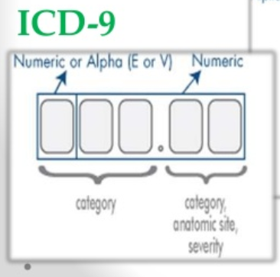
ICD9→ICD10

Slide 18
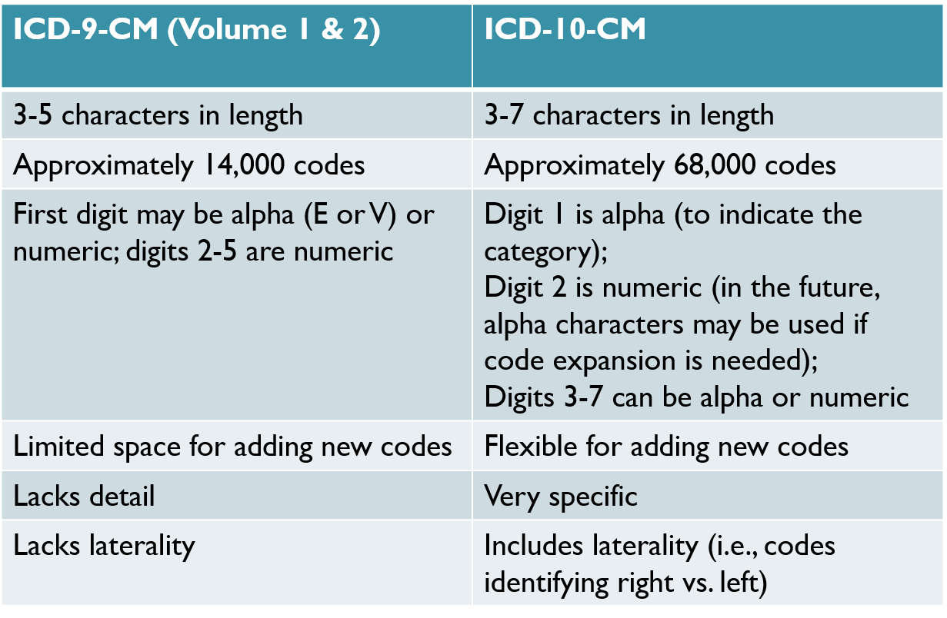
ICD-9-CM vs. ICD-10-CM

Slide 19

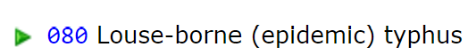
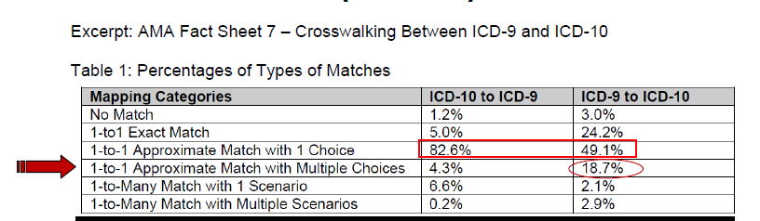
GEMS (General Equivalency Mapping System)
ICD-9-CM ICD-10-CM Flag Meaning
07999 B9789 10000 Approximate Match
080 A750 00000 Exact Match
CAUTION! You cannot rely simply on the GEMS system to cross-match everything. If the flag is other than “00000” there are other potential possibilities. It’s best to start in the alphabetic index and then complete the look up process in the tabular.

Slide 20
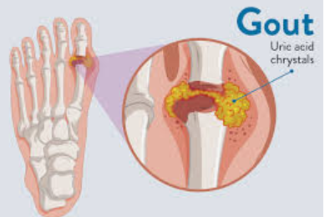
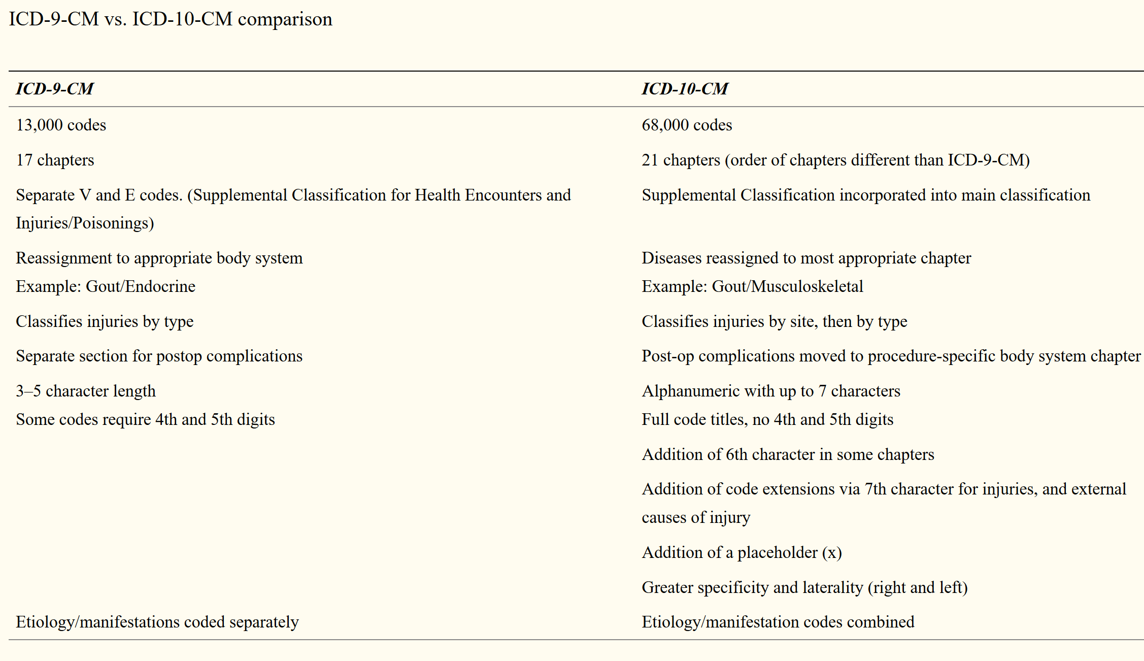
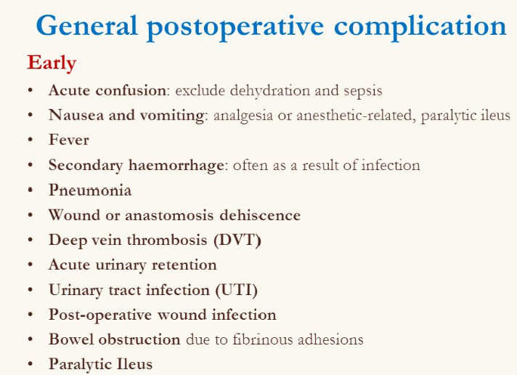
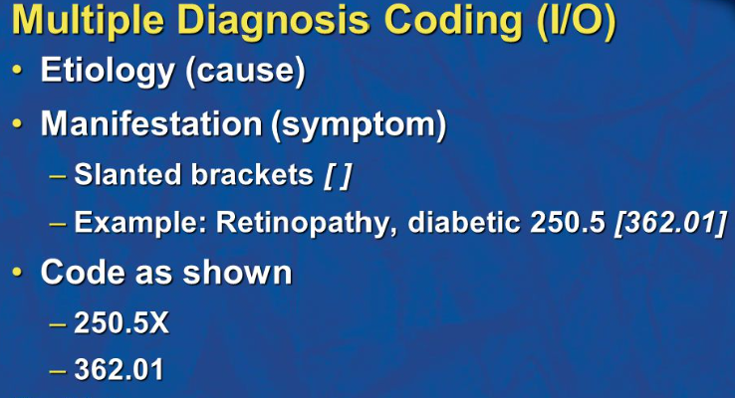
ICD-9-CM vs. ICD-10-CM

Slide 21
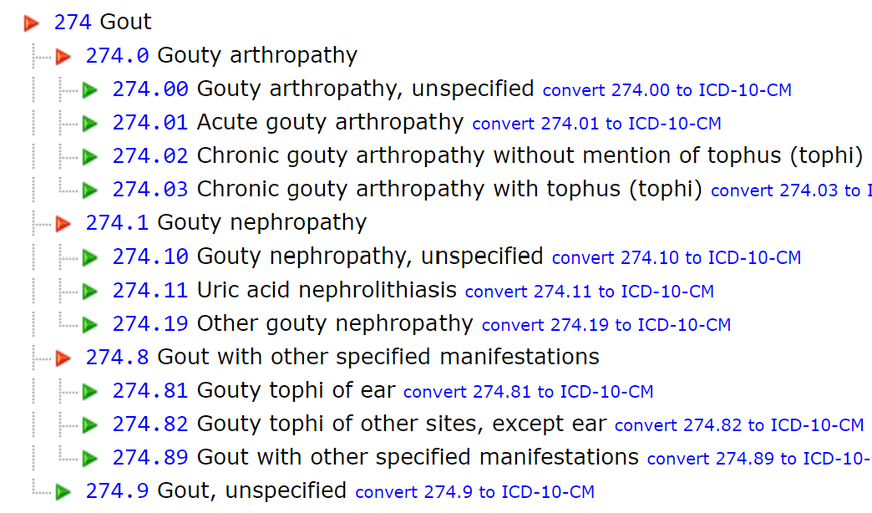
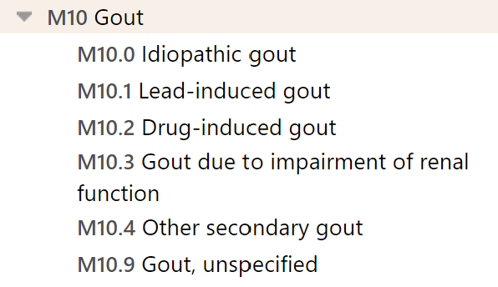
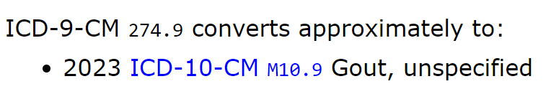
ICD-9-CM vs. ICD-10-CM
https://icd.who.int/browse10/2019/en#/M10
http://www.icd9data.com/2014/Volume1/240-279/270-279/274/default.htm

Slide 22
Examples of the Numbers by Specialty
Specialty | # ICD-9 Codes | # ICD-10 Codes
Gastroenterologists | 596 | 706
Pulmonologists | 255 | 336
Urologists | 389 | 591
Endocrinologists | 335 | 675
Neurologists | 459 | 591
Pediatricians | 702 | 591
Infectious Disease | 1,270 | 1,056

Slide 23
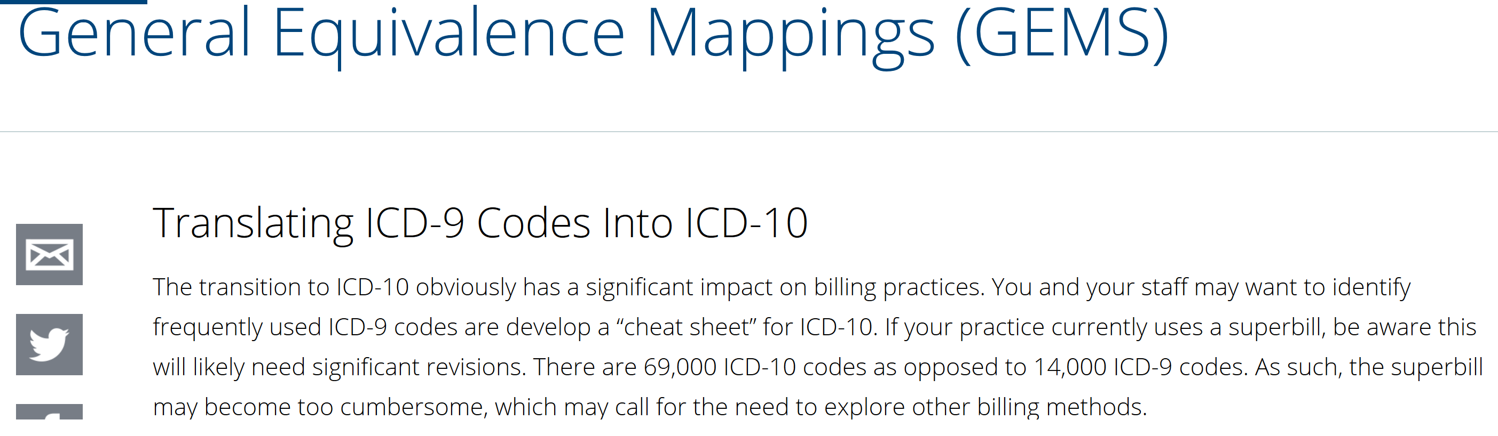
Translating ICD-9 to ICD-10
GEMS (https://www.asco.org/practice-policy/billing-coding-reporting/icd-10/general-equivalence-mappings-gems)
https://www.icd10data.com/Convert

Slide 24
ICD-10 Implementation
Single implementation date of October 1, 2015 for all users
Ambulatory and physician services provided on or after October 1, 2015 will use ICD-10-CM diagnosis codes
Inpatient discharges occurring on or after October 1, 2015 will use ICD-10-CM and ICD-10-PCS codes

Slide 25
Why ICD-10, not ICD-9
Current ICD-9 is:
30 years old
Current code structure limits amount of new codes that can be created
Has obsolete groupings of disease families
Lacks specificity and detail to support:
Accurate anatomical positions
Differentiation of risk & severity
Key parameters to differentiate disease manifestations

Slide 26
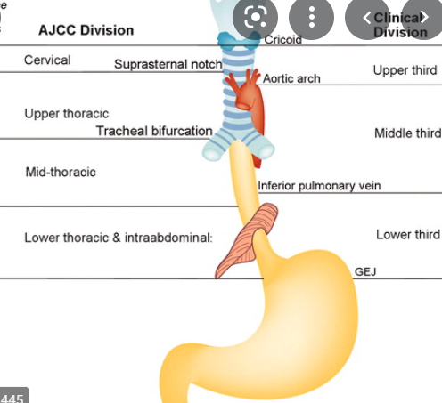
Example
C15 Malignant neoplasm of the esophagus
C15.3 Malignant neoplasm of upper third of esophagus
C15.4 Malignant neoplasm of middle third of esophagus
C15.5 Malignant neoplasm of lower third of esophagus
C15.8 Malignant neoplasm of overlapping lesion of esophagus
C15.9 Malignant neoplasm of esophagus, unspecified
Find above ICD 10 codes:
Please find these on your ICD10 browser: https://icd.who.int/browse10/2019/en (WHO) https://icd10cmtool.cdc.gov/ (CDC)
Notes:
An example of the site is seen in the codes for malignant neoplasm of the esophagus.

Slide 27
ICD-10-CM Code Structure
International Classification of Diseases, 10th Revision, Clinical Modification (ICD-10-CM)
Category
first three
characters
Etiology, anatomic site, severity, fourth, fifth, sixth characters (if applicable)
Extension
seventh
character
(if applicable)
M84 Disorder of continuity
of bone
M84.311- Stress fracture,
right shoulder
M84.311A Stress fracture, right
shoulder; initial encounter

Slide 28
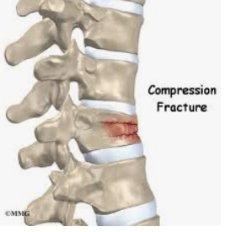
ICD-10-CM (diagnosis) Code Format
2nd – Always Numeric
3rd-7th Alpha or Numeric
Alpha
(except U, Chapter)
Additional Characters
S
3
2
0
1
0
A
Category
Etiology, Anatomic Site, Severity
3-7 Characters
Added code extensions (7th Character) for obstetrics, injuries and external causes of injuries

Slide 29
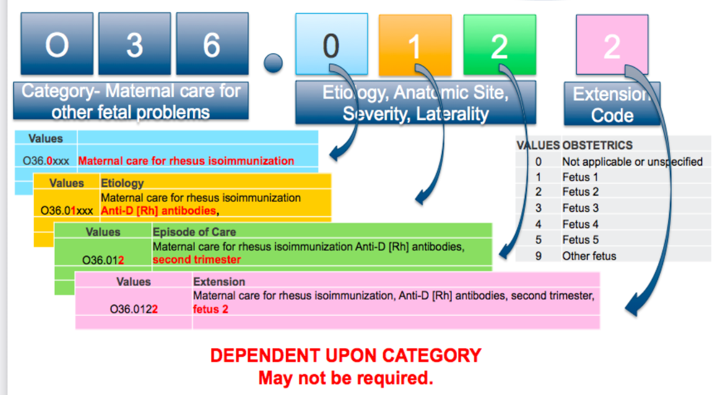
https://nursekey.com/anti-d-preventing-rhesus-isoimmunisation/
Rh incompatibility is when a mother has Rh-negative blood and her baby has Rh-positive blood. Rh isoimmunization is when the blood from the baby makes the mother's body create antibodies that can harm the baby's blood cells.
https://res.cloudinary.com/dpmykpsih/image/upload/gold-coast-site-258/media/28543/icd-10_provider_training_ppt_update_100615.pdf

Slide 30
Format and Structure
Chapter
Three character blocks
Four character categories further define
Site
Etiology
Manifestation
State of the disease or condition
Seventh Character Extenders
Examples:
A – Initial Encounter
D – Subsequent Encounter
S – Sequela- complications or conditions arising from the injury
Notes:
The book is split into chapters. Within each chapter are three character blocks of codes. For example, B15-B19 is for viral hepatitis. The fourth character categories further define the site, etiology, manifestation, state of disease or condition.

Slide 31
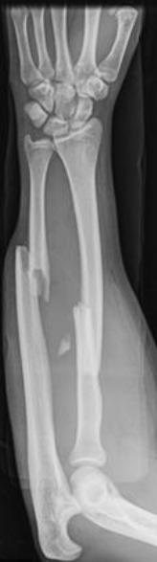
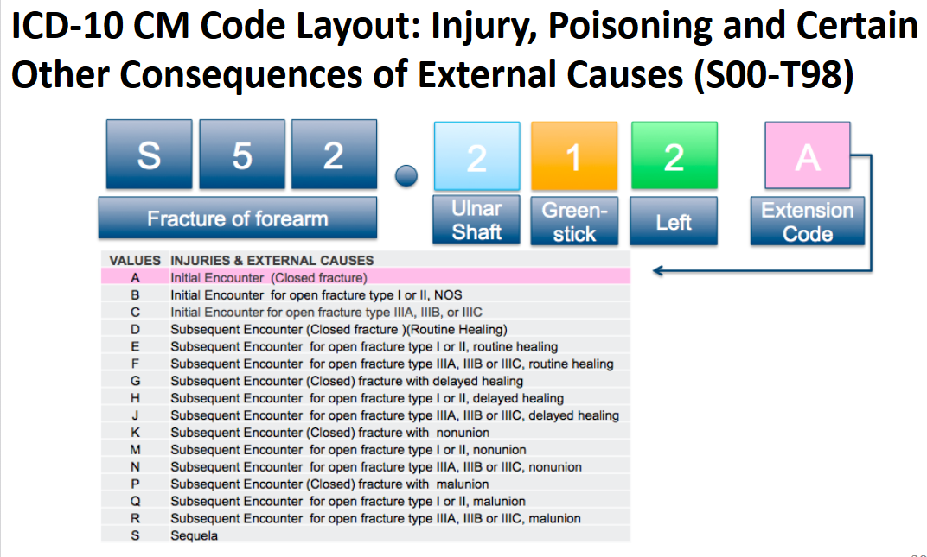
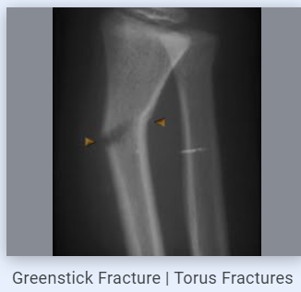

Slide 32

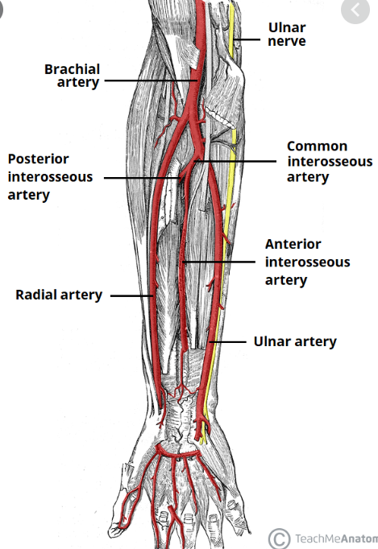
Fifth/Sixth Characters
laceration
Identifies the most precise level of specificity
Example:
S55.011- Laceration of ulnar artery at forearm level, right arm
3 - S55 is a category for injury of blood vessels at forearm level
4 - S55.0 specifies the injury is at the ulnar artery at the forearm level
5 - S55.01 specifies it is a laceration 6 - S55.011 specifies it is of the right arm
A 7th character extender is also required
Notes:
The fifth and sixth character identify the most precise level of specificity.
S55 is a category for injury of blood vessels at forearm level
S55.0 specifies the injury is at the ulnar artery at the forearm level
S55.01 specifies it is a laceration
S55.011 specifies it is of the right arm
This specific code also requires a 7th character extension.

Slide 33
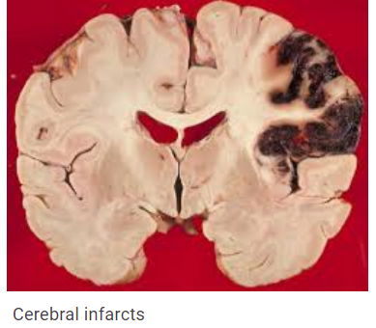
Comparison: ICD-9 to ICD-10
434.11 | Cerebral embolism with infarction
Code represents embolism of cerebral arteries with infarction
I63.40 | Cerebral infarction dew to embolism of unspecified cerebral artery
I63.49 | Of other cerebral artery
I63.411 | Of right middle cerebral artery
I63.412 | Of left middle cerebral artery
I63.419 | Of unspecified middle cerebral artery
I63.421 | Of right anterior cerebral artery
I63.422 | Of left anterior cerebral artery
I63.429 | Of unspecified anterior cerebral artery
I63.431 | Of left posterior cerebral artery
I63.432 | Of right posterior cerebral artery
I63.439 | Of unspecified posterior cerebral artery
I63.441 | Of right cerebellar artery
I63.442 | Of left cerebellar artery
I63.449 | Of unspecified cerebellar artery
With specificity and laterality, one ICD-9 code translates into 14 possible ICD-10 codes

Slide 34
New Features in ICD-10-CM
Laterality (Left, Right, Bilateral)
Combination codes for certain conditions and common associated symptoms and manifestations
Combination codes for poisonings and their associated external cause
Obstetric codes identify trimester instead of episode of care

Slide 35
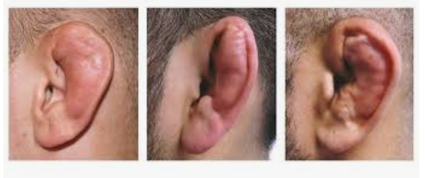
Laterality Example:
H61.12 Hematoma of pinna
H61.121 Hematoma of pinna, right ear
H61.122 Hematoma of pinna, left ear
H61.123 Hematoma of pinna, bilateral ears
H61.129 Hematoma of pinna, unspecified ear
Hematoma of Pinna: A deformity of the outer ear that may occur after injury to the ear.

Slide 36
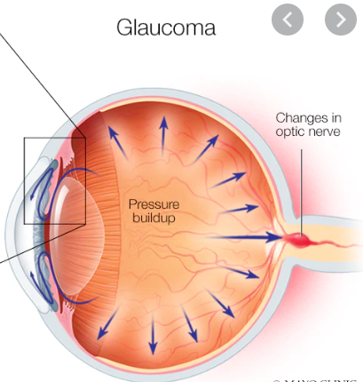
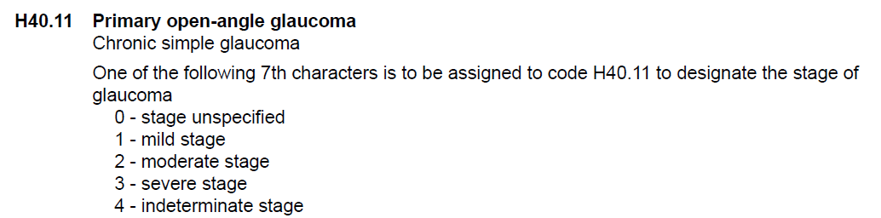
New Features in ICD-10-CM Placeholder “X” Character
4. Placeholder character
The ICD-10-CM utilizes a placeholder character “X”. The “X” is used as a placeholder at certain codes to allow for future expansion. An example of this is at the poisoning, adverse effect and underdosing codes, categories T36-T50. Where a placeholder exists, the X must be used in order for the code to be considered a valid code.
Example:
H40.11X1 Mild stage primary open-angle glaucoma

Slide 37
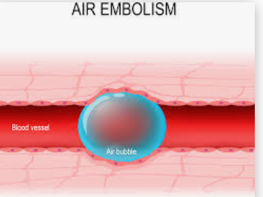
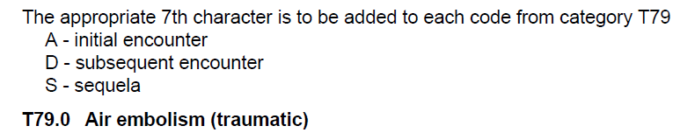
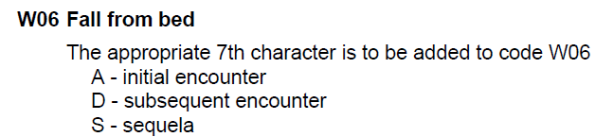
5. 7th Characters
Certain ICD-10-CM categories have applicable 7th characters. The applicable 7th character is required for all codes within the category. The 7th character must always be the 7th character in the data field. If a code that requires a 7th character is not 6 characters, a placeholder X must be used to fill in the empty characters.
Example 1:
Some codes have even more!
Example 2:
ICD-10-CM says the seventh character S is “for use for complications or conditions that arise as a direct result of an injury, such as scar formation after a burn. The scars are sequelae of the burn.” In other words, sequela are the late effects of an injury
T79.0XXA Initial encounter for a traumatic air embolism
W06.XXXD Subsequent encounter for a fall from a bed

Slide 38
Chapter Changes: Diabetes Mellitus
Diabetes mellitus is located in Chapter 3, Endocrine, Nutritional and Metabolic Diseases, and Immunity Disorders in ICD-9-CM (250)
Diabetes mellitus is located in Chapter 4, Endocrine, Nutritional and Metabolic Disorders in ICD-10-CM (E00-E89)
https://www.icd10data.com/ICD10CM/Codes
Notes:
In ICD-9-CM DM is in Ch 3. In ICD-10-CM, it is Ch 4.

Slide 39
Diabetes Mellitus
There are five (5) Diabetes Mellitus categories in the ICD-10-CM to reflect the current clinical classifications of diabetes. They are:
E08 Diabetes Mellitus due to an underlying condition
E09 Drug or chemical induced diabetes mellitus
E10 Type I diabetes mellitus
E11 Type 2 diabetes mellitus
E13 Other specified diabetes mellitus
https://www.icd10data.com/ICD10CM/Codes
Notes:
All the categories above with the exception of E10 include a note directing users to use an additional code to identify any insulin use, which is Z79.4. The concept of insulin and non-insulin requiring are not a component of the DM (diabetes mellitus) categories in ICD-10-CM. Code Z79.4 (long-term current use of insulin) is added to identify the use of insulin for diabetic management even if the patient is not insulin dependent in code categories E08-E09 and E11-E13. (no E12)
The fourth character under these categories refer to underlying conditions with specified complications, whereas, the fifth character defines the specific manifestation such as neuropathy, angiopathy, etc.

Slide 40
Diabetes Mellitus
ICD-9-CM has fifth-digit subclassifications that state the type of diabetes (including unspecified) and whether the diabetes is uncontrolled or not stated as uncontrolled
250.00 Diabetes without mention of complication, NOS, not stated as uncontrolled
ICD-10-CM has no stated unspecified code, so the default is type II and no longer classified as uncontrolled/ controlled
E10.11 Type 1 diabetes mellitus with ketoacidosis with coma
Notes:
These codes are now categorized to indicate if the patient is with or without complications. Still reporting the same type of information, but using different terminology.

Slide 41
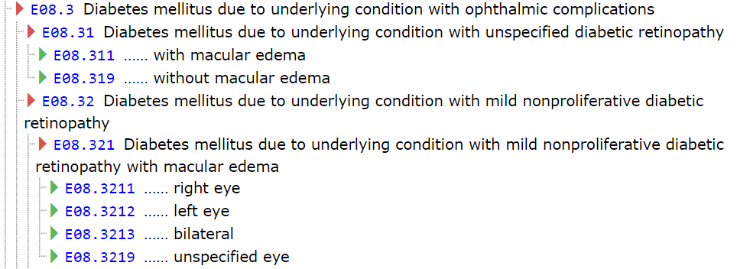
Diabetes Mellitus
Combination codes are used in ICD-10-CM for diabetes
The three character category shows the type of diabetes
The fourth character shows the underlying conditions with specified complications
The fifth character defines the specific manifestation
Notes:
Combination codes are created to have the manifestations included in the diabetes codes, this will actually allow us to report fewer codes in ICD-10-CM

Slide 42
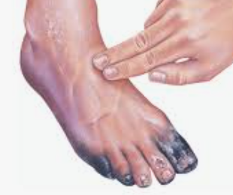
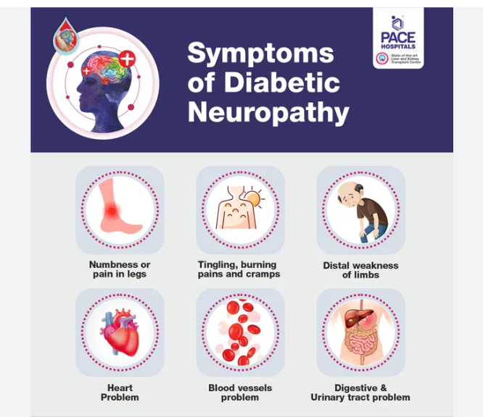
Diabetes Mellitus
E08.22 Diabetes mellitus due to an underlying condition with diabetic chronic kidney disease
E09.52 Drug or chemical induced diabetes mellitus with diabetic peripheral angiopathy with gangrene
E11.41 Type 2 diabetes mellitus with diabetic mononeuropathy
https://www.icd10data.com/ICD10CM/Codes/E00-E89/E08-E13/E08-/E08.22
Notes:
As you can see from the slides above, the combination codes may allow us to report less codes for diabetic patients.

Slide 43
Diabetes Mellitus
In ICD-10-CM there is a code, Z79.4 long-term current use of insulin, that is used the same way we currently use V58.67 in ICD-9-CM
ICD-10 Code Z79. 4, Long-term (current) use of insulin should be assigned to indicate that the patient uses insulin for Type 2 diabetes mellitus (Category E11* codes). Z79. 4 should NOT be used for Type 1 diabetes mellitus (Category E10* codes).
Notes:
All the categories above with the exception of E10 include a note directing users to use an additional code to identify any insulin use, which is Z79.4. The concept of insulin and non-insulin requiring are not a component of the DM (diabetes mellitus) categories in ICD-10-CM. Code Z79.4 (long-term current use of insulin) is added to identify the use of insulin for diabetic management even if the patient is not insulin dependent in code categories E08-E09 and E11-E14.

Slide 44
Examples about coding Diabetes Mellitus
Coding a type 2 diabetic patient evaluated for a chronic diabetic left foot ulcer with necrosis of muscle. The patient takes insulin on a daily basis. The coding would follow:
E11.621, Type 2 diabetes mellitus with foot ulcer
L97.523, Non-pressure chronic ulcer of other part of left foot with necrosis of muscle
Z79.4, Long term (current) use of insulin

Slide 45
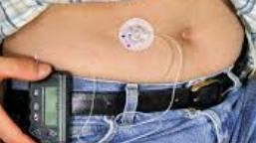
Examples about coding Diabetes Mellitus
Coding a type 1 diabetic patient is seen in the ED for an initial encounter to evaluate the leakage of her insulin pump, then the code assignment would be:
T85.633A, Leakage of insulin pump, initial encounter
E10.69, Type 1 diabetes mellitus with other specified complication

Slide 46
Neoplasms
A patient may have a malignancy in two or more sites in the same organ, which may represent different primaries or metastatic disease
The ICD-10-CM guidelines state to query the provider for the status of each tumor so that the correct codes can be assigned
Reference: ICD-10-CM Official Draft Guideline C.2.i
Accurate sequencing for primary and secondary cancer depends on which site is being treated or focused upon at the current encounter. For instance, a patient who has primary breast cancer (C50.xx) who is now seen for metastatic bone cancer will have a code for the secondary bone cancer (C79.51) sequenced before a code for the primary breast cancer (C50.xx).
https://www.cms.gov/Medicare/Coding/ICD10/Downloads/2019-ICD10-Coding-Guidelines-.pdf
Notes:
Guideline C.2.i states that a patient may have more than one malignant tumor in the same organ. These tumors may represent different primaries or metastatic disease, depending on the site. Should the documentation be unclear, the provider should be queried as to the status of each tumor so that the correct codes can be assigned. Our providers are going to have to be much more specific in identifying multiple sites and their stage or type in order to code all sites separately.
Location is big in ICD-10 as there are more codes due to laterality and site specificity as compared to ICD-9.

Slide 47
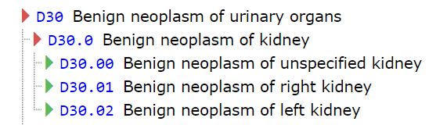
Neoplasms
Laterality is also addressed in ICD-10-CM, unlike ICD-9-CM
Examples: D30.02 Benign neoplasm of left kidney
D04.11 Carcinoma in situ of skin of right eyelid, including canthus
C40.31 Malignant neoplasm of short bones of right lower limb
Notes:
Here are some more examples of how laterality is used in coding for ICD-10-CM.

Slide 48
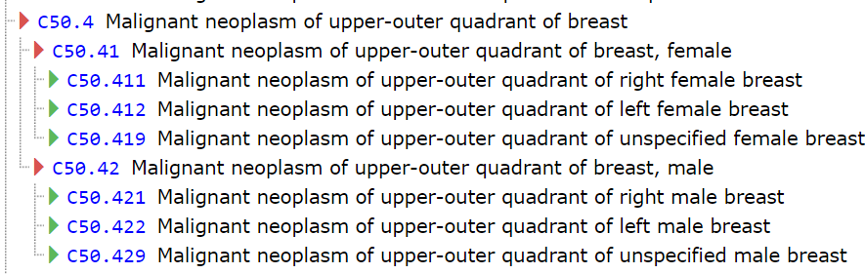
Neoplasm Changes
Malignant neoplasm breast
54 choices for male/female breast
Documentation must include:
Laterality
Location
Use of an additional code to identify estrogen receptor status (if known)
Example: C50.422 malignant neoplasm of upper-outer quadrant of the left male breast
Notes:
54 choices for male/female breast
Documentation must include:
Laterality
Location
Use of an additional code to identify estrogen receptor status
Example: C50.422 Malignant neoplasm of upper-outer quadrant of the left male breast

Slide 49


Neoplasm Changes
Malignant neoplasm of large and small intestine
26 choices available
Specific site (appendix, caput coli, cecum, colon and rectum, ascending, caput, descending colon, distal, left, overlapping. Pelvic, right, sigmoid, hepatic flexure, sigmoid flexure, duodenum, ileum, jejunum…..)
C18.5 Malignant neoplasm of splenic flexure
Notes:
Malignant neoplasm large and small intestine
26 choices available
Documentation must include:
Specific site
Appendix, caput coli, cecum, colon and rectum, ascending, caput, descending, distal, left, overlapping, pelvic, right, sigmoid, hepatic flexure, sigmoid flexure, duodenum, ileum, jejunum…
Example: C18.5 Malignant neoplasm of splenic flexure

Slide 50
Case
A 40 year-old pregnant patient comes in for a consultation for possible chromosomal abnormalities to the fetus. She is carrying a single pregnancy.
ICD-9-CM Codes:
655.83 Other known or suspected fetal abnormality, NEC, antepartum
https://www.icd10data.com/ICD10CM/Codes
ICD-10-CM codes:
O35.1xx0 Maternal care for (suspected) chromosomal abnormality in fetus, not applicable or unspecified
Notes:
In this example, you may think that O35.1XX1 is the right code. But the 7th character notation box states that we should assign the 7th character 0 (not 1) – for single gestations. That the extender 1 for fetus 1 is to be used to indicate the fetus for which the code applies in cases of multiple gestations.

Slide 51
Case
A patient is found to have two distinct malignant tumors in his right lung– one in his right lower lobe and one in his right upper lobe.
ICD-9-CM codes:
162.5 Malignant neoplasm, lower lobe, bronchus or lung
162.3 Malignant neoplasm, upper lobe, bronchus or lung
ICD-10-CM codes:
C34.31 Malignant neoplasm of lower lobe, right bronchus or lung
C34.11 Malignant neoplasm of upper lobe, right bronchus or lung
Note: ICD-10-CM guidelines address multiple malignancies in one organ (Section I.C.2.i). ICD-9-CM guidelines do not.
Notes:
Note that laterality is an issue in ICD-10-CM

Slide 52
Case
Type II diabetic patient presents to the physician’s office for a follow up visit. She has diabetic dermatitis on her left calf that will not resolve. She had recently been started on Humulin N for better diabetes control. At today’s visit the doctor decides to continue the patient on insulin for another month and gives her a prescription for steroids for the skin condition.
ICD-9-CM codes:
250.80 – Type 2 diabetes with other specified manifestations
692.9 – Dermatitis NOS
V58.67 – Long-term (current) use of insulin
ICD-10-CM codes:
E11.620 Type 2 diabetes mellitus with diabetic dermatitis
Z79.4 Long term current use of insulin

Slide 53
Case
A pregnant patient presents to the office for a visit. She is 19 weeks, 3 days, and is diagnosed with a bladder infection caused by E. coli. The doctor told the patient to drink more water and prescribes cephalexin. She is to return in 10 days for a recheck.
ICD-9-CM codes:
646.60 Infections of genitourinary tract in pregnancy
041.49 Other and unspecified Escherichia coli [E.coli]
ICD-10-CM codes:
O23.12 Infections of bladder in pregnancy, second trimester
B96.2 Escherichia coli (E. coli) as the cause of diseases classified elsewhere
Z3A.19 19 weeks gestation of pregnancy

Slide 54
Case
ED visit: A 14 year-old boy is at a movie theater and running in a parking lot when he was hit by a car. He was diagnosed with a nondisplaced fracture of the medial condyle of the lower end of the left femur. The leg was placed in a long leg splint and no further intervention was required.
ICD-9-CM code:
821.21 Fracture of condyle, femoral
Note: Additional E codes are reported to indicate the circumstances surrounding the injury.
ICD-10-CM code:
S72.435A Nondisplaced fracture of medial condyle of left femur, initial encounter for closed fracture
Note: Additional V, W, X, Y codes are reported to indicate the circumstances surrounding the injury.
Notes:
Here we have an ED visit so we would use the initial encounter extension. ICD-10-CM allows us to also report not just that it is a fracture, but also that it is a nondisplaced fracture, the specific location, and the laterality.
There would also be external cause codes to complete the coding scenarios
Guidelines state that if the fracture is not stated as open or closed, the default is closed.

Slide 55
Case
A patient presents to the emergency department after receiving a second degree burn to his left upper arm. TBSA 3%. He receives treatment and is told to follow up with his family physician.
ICD-9-CM code:
943.23 Burn of upper arm, blisters, epidermal loss [second degree]
948.00 Burn [any degree] involving less than 10% of body surface
Note: Additional E codes are reported to indicate the circumstances surrounding the injury.
ICD-10-CM code:
T22.232A Burn of second degree of left upper arm, initial encounter
T31.0 Burns involving less than 10% of body surface
Note: Additional X/Y codes are reported to indicate the circumstances surrounding the injury.

Slide 56
Case
A patient presents for a follow up visit. She had tried to stop her two cats from fighting. One of the cats bit her left hand and right thumb without nail damage. The open wound was washed and she was started on antibiotics. She presents today for a dressing change and wound check.
ICD-9-CM codes:
883.0 Open wound of finger(s), without mention of complication
882.0 Open wound of hand except finger(s) alone, without mention of complication
Note: E codes are not reported for subsequent encounters (Section I.C.19.a.2.)
ICD-10-CM codes:
S61.051D Open bite of right thumb without damage to nail, subsequent encounter
S61.452D Open bite of left hand, subsequent encounter
W55.01XD Bitten by cat
Note: External cause codes are reported for each encounter for which the injury or condition is being treated.
Notes:
Cat Bite
There would be an external cause code W55.01XD to show bitten by cat
7th character d represents a follow up encounter.
We would also use additional codes for place of occurrence, activity, external cause status, but the example here is mainly focused on the injury codes themselves.

Slide 57


ICD10 in EHR
ICD 10
COVID-19 patient diagnosis from 4CE (i2b2):
https://figshare.com/articles/Diagnosis_Data_for_International_Electronic_Health_Record-Derived_COVID-19_Clinical_Course_Profile_The_4CE_Consortium/12152967

Slide 58

ICD9 in EHR
Finding ICD 9 code for MIMIC III Demo Data
https://physionet.org/content/mimiciii-demo/1.4/DIAGNOSES_ICD.csv
ICD9: http://www.icd9data.com/2015/Volume1/default.htm

Slide 59
ICD-10 Provider Impacts
Clinical documentation is the foundation of successful ICD-10 Implementation
Golden Rule of Documentation
If it isn’t documented by the physician, it didn’t happen
If it didn’t happen, it can’t be billed
The purpose in documentation is to tell the story of what was performed and what is diagnosed accurately and thoroughly reflecting the condition of the patient
what services were rendered and
what is the severity of the illness
The key word is SPECIFICITY
Granularity
Laterality
Complete and concise documentation allows for accurate coding which leads to maximized reimbursement

Slide 60


ICD10 Specificity

Slide 61
ICD-10 Changes Everything
ICD-10 changes the clinical practice.
ICD-10 Implementation will impact everyone:
Registration, Nurses, Managers, Lab, Clinical Area, Billing, Physicians, and Coding.

Slide 62
Resources
AHIMA: https://www.ahima.org/education-events/education-by-topic/coding/
AMA: https://www.ama-assn.org/practice-management/claims-processing/icd-10-overview
CMS: https://www.cms.gov/icd10/
CDC: https://www.cdc.gov/nchs/icd/icd-10-cm.htm
WHO: https://icd.who.int/browse10/2019/en
ICD9: http://www.icd9data.com/2015/Volume1/default.htm
https://www.slideshare.net/CureMDHealthcare/icd10-fundamentals-and-navigation

